Slide 1
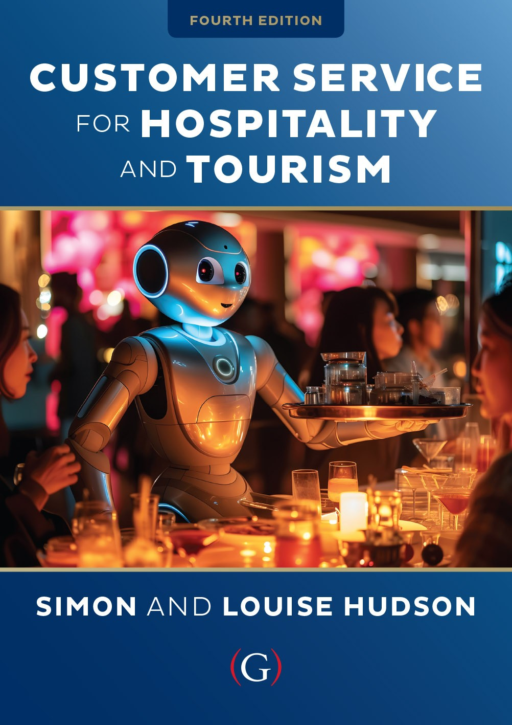
Chapter 7
Building and maintaining customer relationships

Slide 2
Topics Covered
Relationship Marketing
Retention Strategies
Loyalty programs
Benefits of Relationship Marketing
Targeting profitable customers

Slide 3

‘At Your Service’ Spotlight: Soho House – building and maintaining a loyal customer base
With more than 40 locations globally Soho House is known for fostering creativity and bringing members together to connect
Soho House is notorious for its selective club membership policy.
Members (there are now over 190,000) are loyal once they are in, as the company’s retention rate is roughly 95%.
Soho House employs a large in-house team of designers and architects to design the interiors, furniture and other elements that go into each new build.

Slide 4
Relationship marketing
A form of marketing that attracts customers,
retains them, and enhances their satisfaction.
Less expensive to attract repeat customers
Dramatic increases in profits
  Repeat customers generate twice as much gross income as new customers
Enhancing customer satisfaction includes:
  Nurturing individual relationships
  Making customers feel unique
  Making customers feel singled out for attention
  Loyalty programs

Slide 5
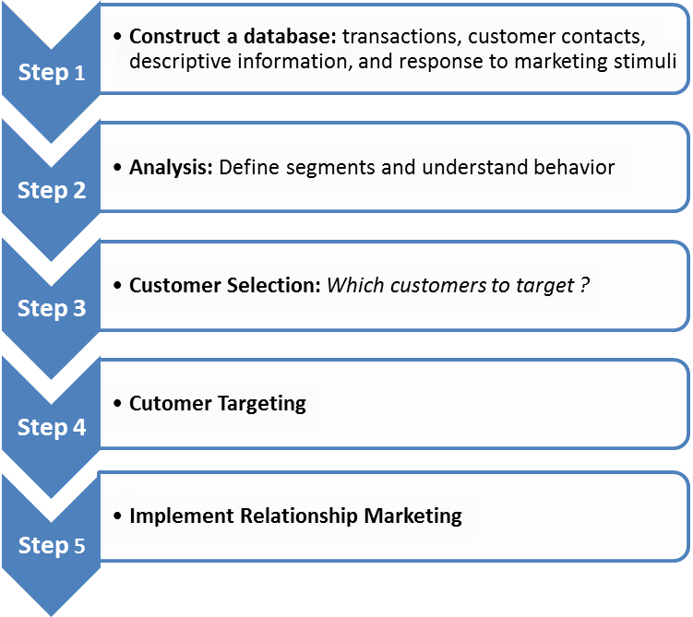
Customer Relationship Management Model
Figure 7.1 (Source: Based on Winer, 2001)

Slide 6
Levels of retention strategies
Figure 7.2 (Source: Adapted from Zeithaml and Bitner, 2000)

Slide 7
Loyalty programs
Extremely common in hospitality and tourism
Customized reward programs are growing
Coalition model is also more common
Airlines
  Frequent flyer rewards
  Highest fare holders
  Elite status customers
Hotels
  Complimentary meals, internet access
  Included in franchise fees
  Joint programs for smaller brands, boutique hotels
Restaurants
  Rewards Cards
  Non-financial incentives e.g. ‘Jump the Line’ perk
Notes:
Loyalty programs
Extremely common in hospitality and tourism
Customized reward programs are growing
Coalition model is also more common
Airlines
Frequent flyer rewards
Highest fare holders
Elite status customers
Hotels
Complimentary meals, internet access
Included in franchise fees
Joint programs for smaller brands, boutique hotels
Restaurants
Rewards Cards
Non-financial incentives e.g. ‘Jump the Line’ perk

Slide 8
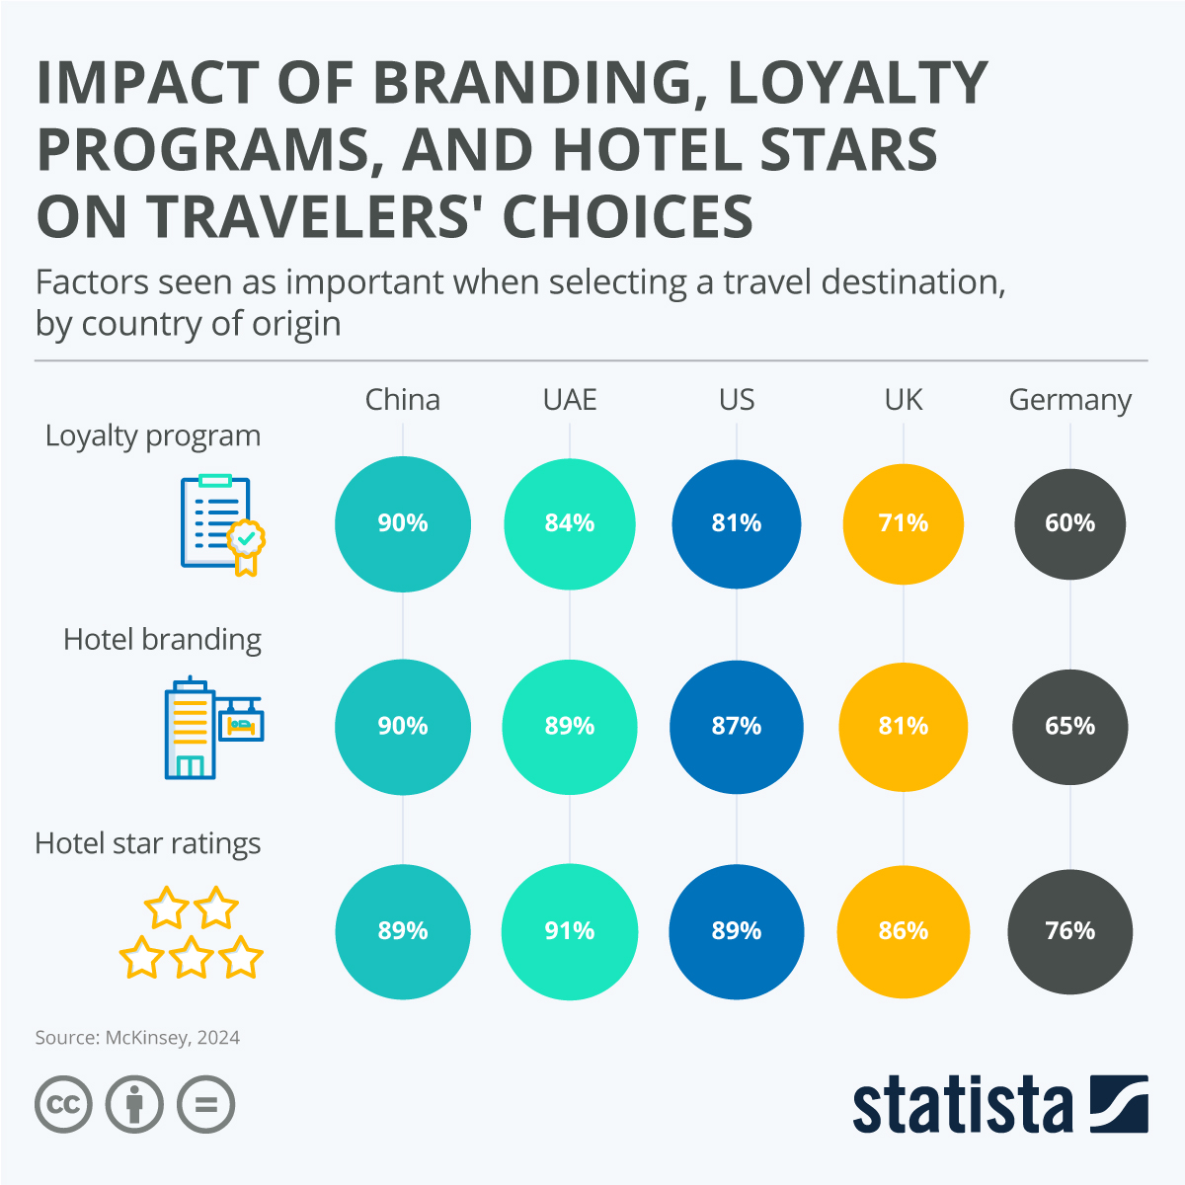

Slide 9
Service loyalty classification scheme
Figure 7.3 (Source: Adapted from Dick and Basu, 1994)

Slide 10

Snapshot: African-American travelers – an increasingly profitable market
African-American travel market is the third fastest growing segment in the US travel sector
African-Americans travel most frequently for leisure purposes (79%), especially to visit friends and relatives
The quality of service and quality of accommodation are their top two priorities
Providers have been slow in targeting this segment but some have spotted the opportunity
For example, destinations hosting the National Brotherhood of Skiers (NBS)

Slide 11
Benefits of Relationship Marketing
Customers loyalty incentives:
  High perceived value
  ‘Get’ should exceed ‘Give’
  Rewards for loyalty
Company benefits:
  Higher profits through retaining customers
    More purchases overall
    More frequent purchases
  Lowers operating costs
    No acquisition costs
  Increases company referrals

Slide 12
Benefits of relationship marketing
Table 7.2

Slide 13
Targeting profitable customers
Building and improving upon traditional segmentation
Studying loyalty- versus defection-prone customers
  Identify profitability bands
  Identify customers most likely to remain loyal
  Develop overall strategy around these customers
    Target with retention strategies
  Other customers too costly to retain
    Little potential to become profitable

Slide 14
The 80/20 customer pyramid
Figure 7.4 (Source: Adapted from Zeithhaml and Bitnen, 2000)
Notes:
S

Slide 15
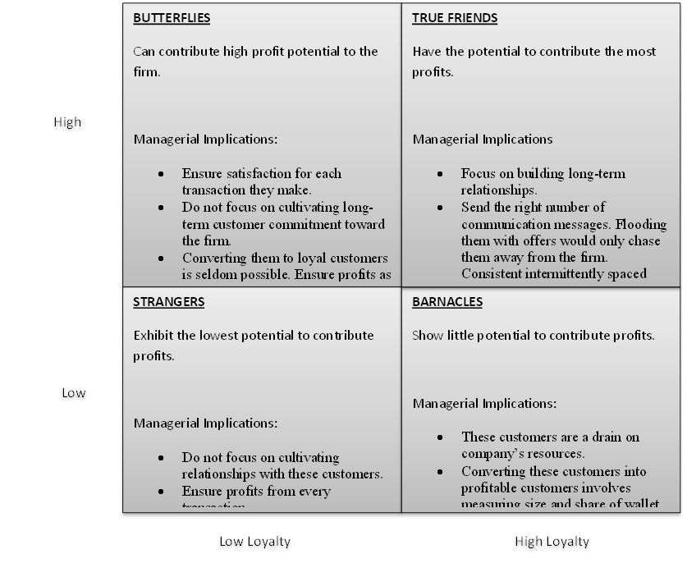
Managing loyalty and profitability
Figure 7.5 (Source: Adapted from Kumar and Rajan, 2009, p. 5)

Slide 16
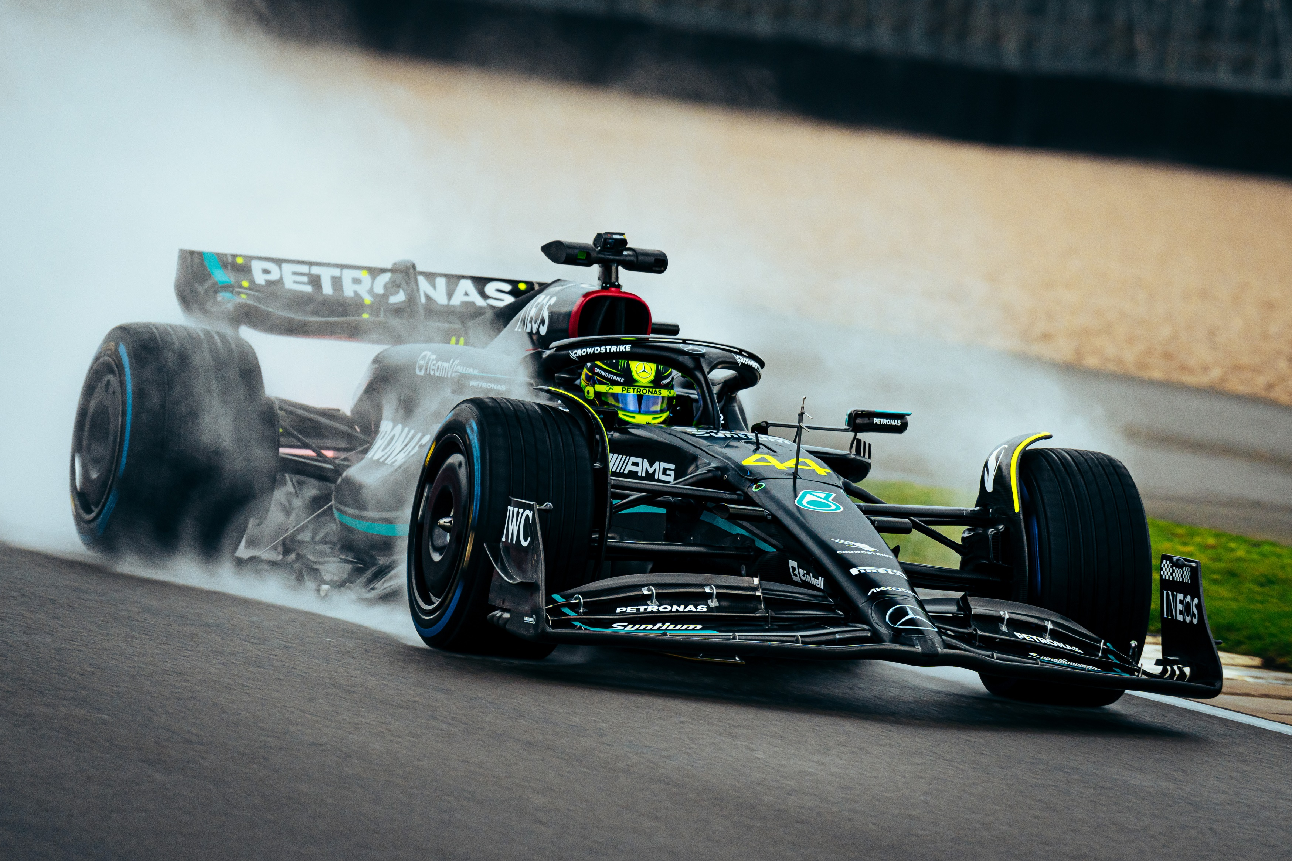
Case study: Marriott Bonvoy ‘ driving’ customer loyalty
Under the terms of a multi-year marketing agreement between Marriott and Mercedes-AMG PETRONAS Formula 1 Team, Marriott Bonvoy – the hotel’s loyalty program - is the racing team's ‘Official Hotel Loyalty Program,’ while the company's luxury brand The Ritz-Carlton is the team’s first ‘Official Hotel Partner.’
The partnership offers exclusive experiences for Marriott Bonvoy members who have the chance to redeem their points for some 'money-can't-buy' experiences, such as spending the night on the team's hospitality suite yacht during the Monaco Grand Prix or doing a Pit Stop Challenge with the team.
“Our partnership brings together two likeminded brands that share a commitment to excellence and a desire to create unforgettable experiences”

